Slide 1
Against the Wind Episode 3 Interview Slides
Luke Yamaguchi

Slide 2
https://www.cdc.gov/nchs/nvss/vsrr/covid_weekly/index.htm#Comorbidities
Notes:
https://www.cdc.gov/nchs/nvss/vsrr/covid_weekly/index.htm#Comorbidities

Slide 3
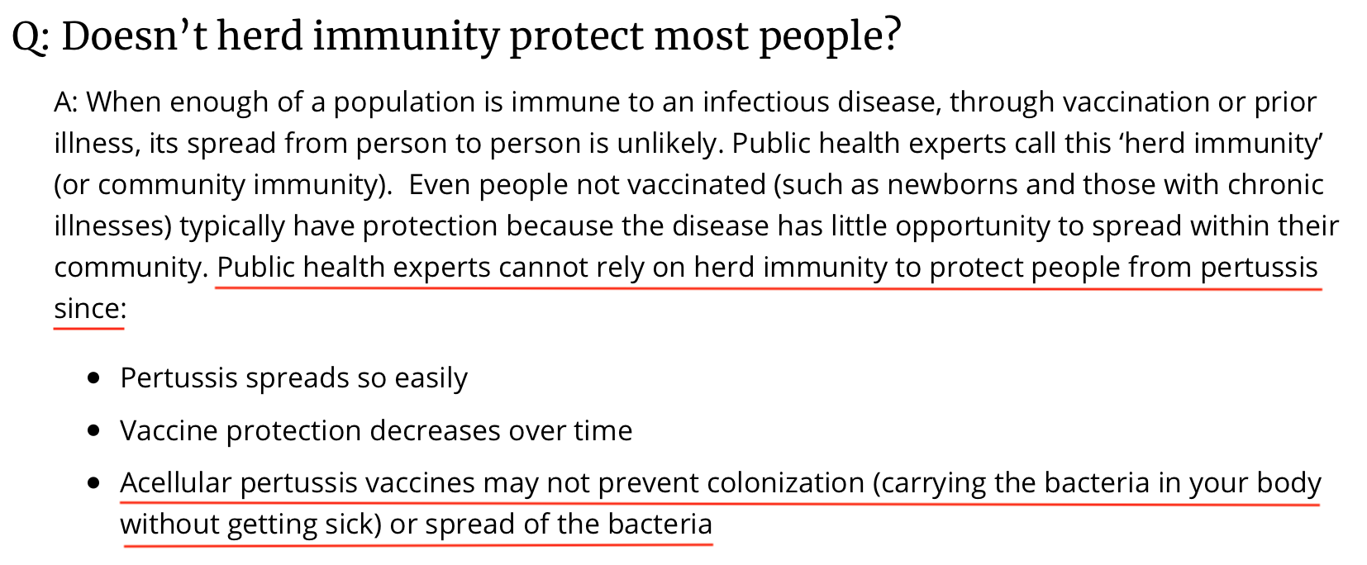
https://www.cdc.gov/pertussis/about/faqs.html#immunity
Notes:
https://www.cdc.gov/pertussis/about/faqs.html#immunity

Slide 4
Notes:
https://www.cdc.gov/vaccines/acip/meetings/downloads/slides-2020-10/COVID-Anderson.pdf

Slide 5
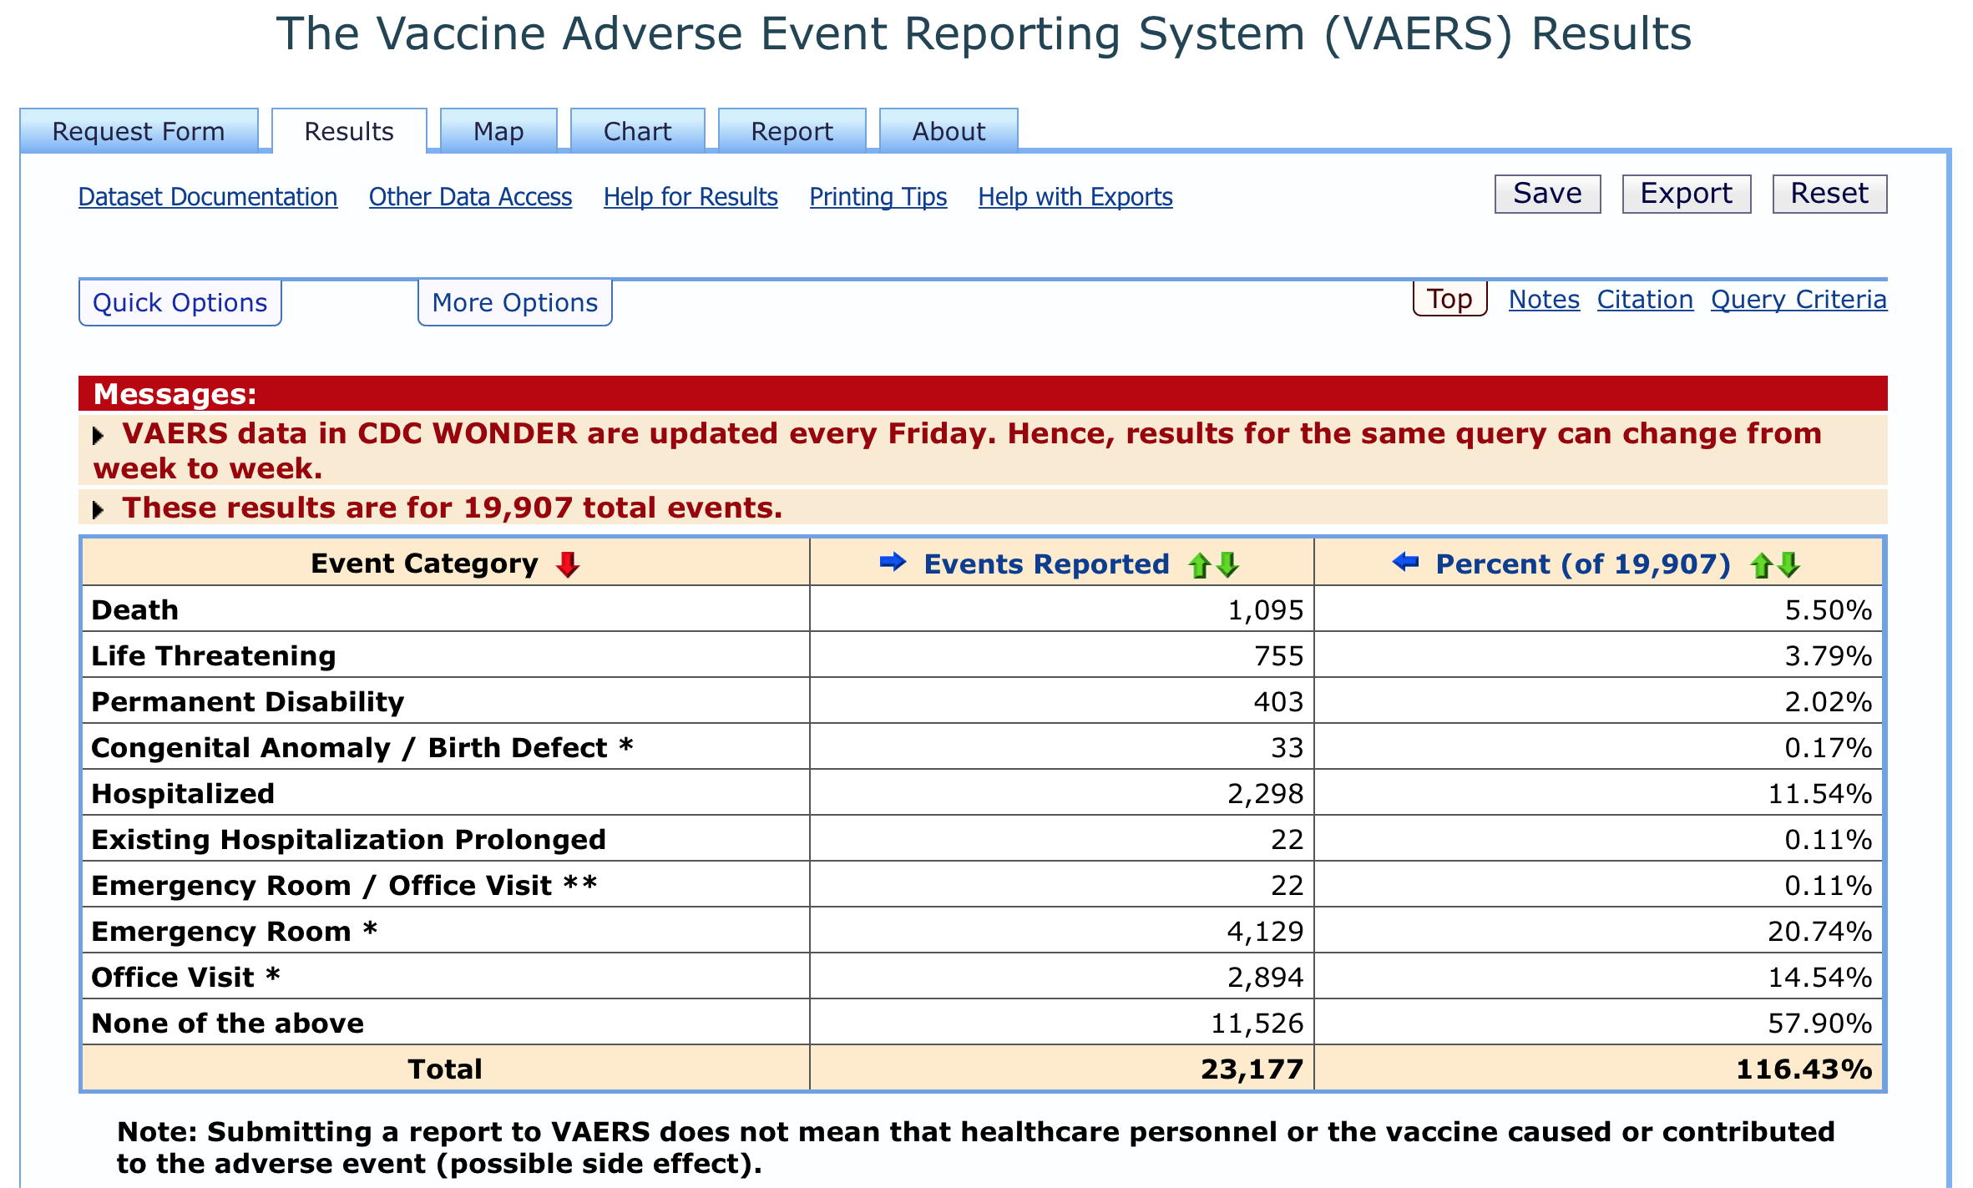
Notes:
wonder.cdc.gov/vaers.html (Data as of February 19, 2021 for Moderna and Pfizer’s mRNA Covid vaccines)

Slide 6
Notes:
www.openvaers.com/covid-data

Slide 7
https://www.fda.gov/media/144637/download
Notes:
https://www.fda.gov/media/144637/download

Slide 8
Notes:
www.gutresolution.com

Slide 9
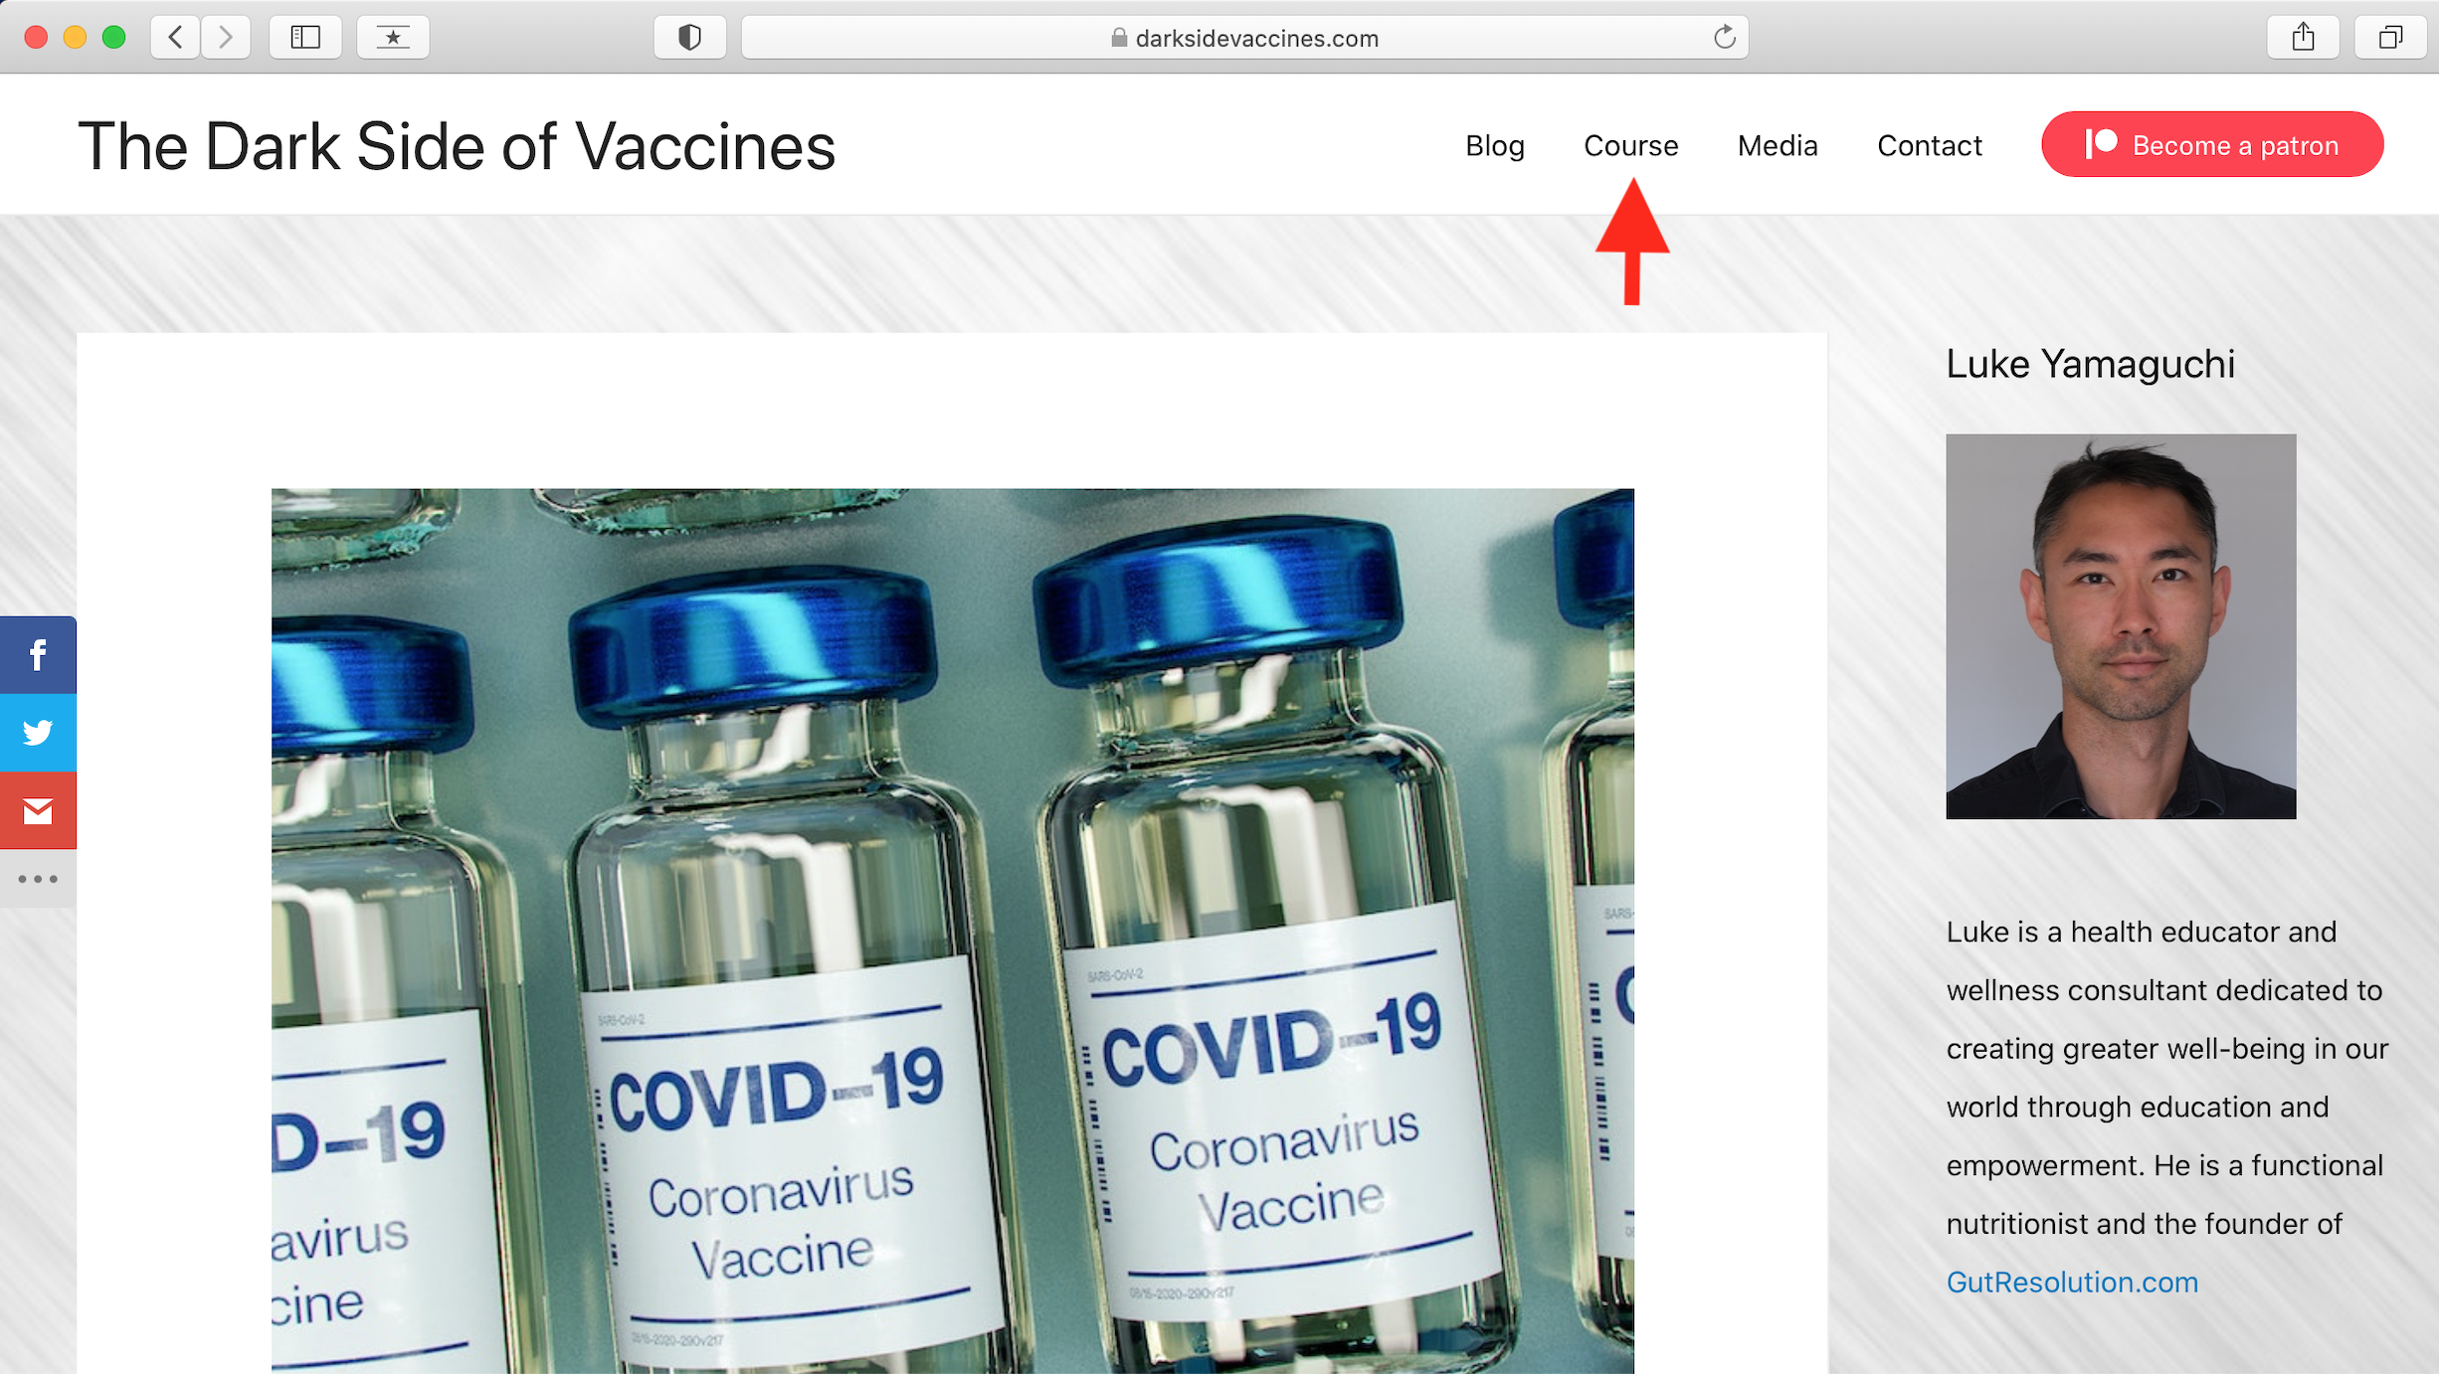
Notes:
www.darksidevaccines.com

